Slide 1
Science Practical Journal
Practicals 1–12 with answers for the blank spaces
Chemistry and physics experiments, journal pages 2–30. Suggested answers are marked; items to verify are flagged.

Slide 2
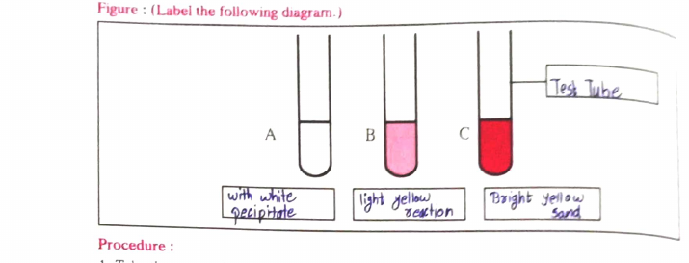
Practical 1: Identifying Cl⁻, Br⁻ and I⁻ ions
From the journal
Aim: identify chloride, bromide and iodide ions in salts
Apparatus: test tubes, stand
Chemicals: AgNO₃, KCl, KBr, KI solutions
Procedure: 5 mL KCl (A), KBr (B), KI (C); add 5 mL AgNO₃, stir, observe
Table: A white AgCl↓, B light yellow AgBr↓, C bright yellow AgI↓
Answers for the blanks / MCQs
Result explained
Diagram: Test Tube; A white precipitate; B light yellow; C bright yellow
B: KBr + AgNO₃ → KNO₃ + AgBr↓; C: KI + AgNO₃ → KNO₃ + AgI↓
Conclusion: double displacement reactions occur; halogens (group 17) behave alike
MCQ: 1 a (one); 2 d (fluorine); 3 c (bromine); 4 a (increases); 5 d (increases then decreases)
Silver ions combine with each halide ion to form an insoluble silver halide, so a coloured precipitate appears. The shade (white, light yellow, bright yellow) tells chloride, bromide and iodide apart.
Practical 1 · Journal pp. 2–3

Slide 3
Practical 1: Exercise (Halogens and Group 0)
From the journal
Result explained
Q1 Explain gradation in reactivity of halogens
Q2 Similarities of halogen elements
Q3 Why are inert gases in the zero group?
Halogens sit in group 17 with 7 valence electrons, so each gains one electron. Reactivity falls down the group as the atom gets larger. Inert gases already have a full shell.
Answers for the blanks / MCQs
Q1: reactivity decreases down group 17 (F most reactive); each needs 1 electron to complete its octet
Q2: all have 7 valence electrons, valency 1, non-metals
Q3: completely filled outer shell, zero valency, non-reactive
Practical 1 · Journal p. 3

Slide 4
Practical 2: Types of Chemical Reactions
From the journal
Result explained
I Mg burns in air: 2Mg + O₂ → 2MgO, luminous flame, white powder
II Zn + dil. H₂SO₄ → ZnSO₄ + H₂: colourless gas burns with blue flame
III Heat Pb(NO₃)₂: 2Pb(NO₃)₂ → 2PbO + 4NO₂ + O₂; brown gas turns blue litmus red, splinter keeps glowing
Each reaction shows a different pattern: two reactants joining (combination), one element replacing another (displacement), one compound splitting (decomposition). Counting reactants and products identifies the type.
Answers for the blanks / MCQs
Mg: 2 reactants, 1 product, combination
Zn: 2 reactants, 2 products, displacement (journal entry 4 and 24 looks wrong: verify)
Pb(NO₃)₂: 1 reactant, 3 products, decomposition (journal entry 3 and 3: verify)
MCQ: 1 a; 2 a (MgO alkaline); 3 a (colourless)
Practical 2 · Journal pp. 4–5

Slide 5
Practical 2: Exercise
From the journal
Result explained
Q1 Why are some liquid medicines kept in dark bottles?
Q2 Why do edible oils turn rancid?
Q3 BaSO₄ + 4C → BaS + 4CO: oxidation or reduction?
Q4 Example each of displacement, decomposition and combination
Light, air and oxygen change chemicals, which is why storage matters. In the BaSO₄ reaction oxygen is lost by barium sulphate and gained by carbon, so reduction and oxidation happen together.
Answers for the blanks / MCQs
Q1: light can decompose the medicine; dark glass cuts light
Q2: oxidation of oils and fats gives bad smell and taste
Q3: BaSO₄ is reduced (loses oxygen); C is oxidised; a redox reaction
Q4: displacement Zn + H₂SO₄; decomposition heating Pb(NO₃)₂; combination Mg + O₂
Practical 2 · Journal p. 6

Slide 6
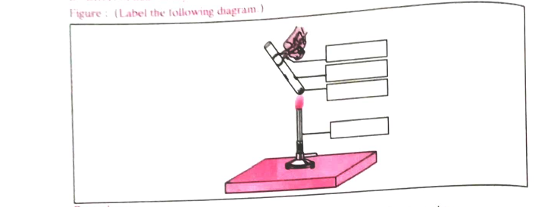
Practical 3 A and B: Lime with Water; Heating Ferrous Sulphate
From the journal
A CaO(s) + H₂O(l) → Ca(OH)₂(aq)
Observed: heat evolved, steam, hissing sound, solid and liquid form aqueous Ca(OH)₂
B 2FeSO₄·7H₂O →(heat) Fe₂O₃ + SO₂ + SO₃ + 14H₂O
Pale green crystals decompose on heating
Answers for the blanks / MCQs
Result explained
A: combination, exothermic; product is aqueous solution of calcium hydroxide
B: original colour pale green; gases SO₂ and SO₃; residue reddish brown Fe₂O₃
Gas colour and diagram labels: verify against your own observation
Quicklime and water release heat, so it is exothermic and the water turns to steam. Heating green ferrous sulphate crystals gives reddish-brown iron oxide, so a colour change signals a new substance.
Practical 3 · Journal pp. 7–8

Slide 7
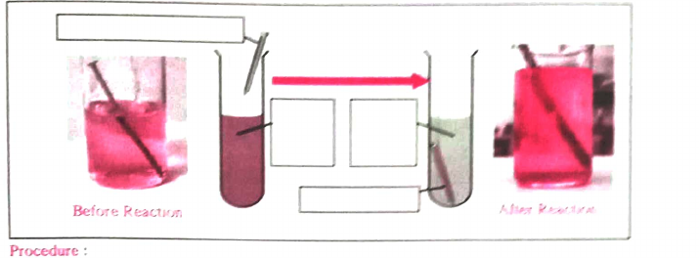
Practical 3 C and D: Iron with CuSO₄; Na₂SO₄ with BaCl₂
From the journal
C Fe(s) + CuSO₄(aq) → FeSO₄(aq) + Cu(s)
D BaCl₂(aq) + Na₂SO₄(aq) → BaSO₄(s) + 2NaCl(aq)
Observation tables: record your own colours
Answers for the blanks / MCQs
Result explained
C: iron displaces copper; nail turns reddish brown; displacement reaction
D: white insoluble BaSO₄ (precipitate); double displacement
MCQ p.10: 1 c; 2 a (red); 3 b; 4 c
MCQ p.11 Q5: c (Cu)
Ex: scrubber has more surface area; residue Fe₂O₃; CaO + water is also exothermic
Iron is more reactive than copper, so it pushes copper out of the blue solution; the solution fades to pale green. In D, ions swap partners and insoluble BaSO₄ appears as a white precipitate.
Practical 3 · Journal pp. 9–11

Slide 8
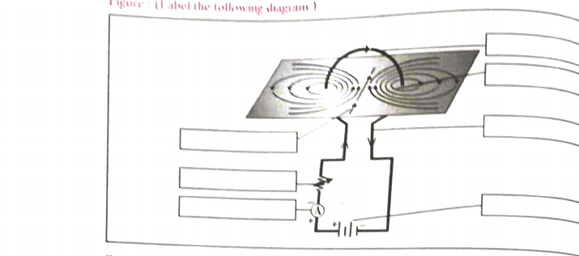
Practical 4: Magnetic Field due to Current in a Coil
From the journal
Aim: study magnetic field due to current in a coil
Apparatus: insulated copper wire, battery, cardboard, iron filings
Coil of 20 to 25 turns; spread iron filings; pass current; tap gently
Answers for the blanks / MCQs
Result explained
Blank 1 and inference 1: magnetic lines of force (field)
Observation 2: circles become larger and weaker away from wire
Inference 2: depends on the current
MCQ: 1 d; 2 a; 3 c; 4 c; 5 d (verify)
Ex 1: rubber insulation prevents shock and short circuit
Current produces a magnetic field around the wire, and iron filings line up along its field lines. Larger current gives a stronger field and clearer, denser lines near the wire.
Practical 4 · Journal pp. 12–13

Slide 9
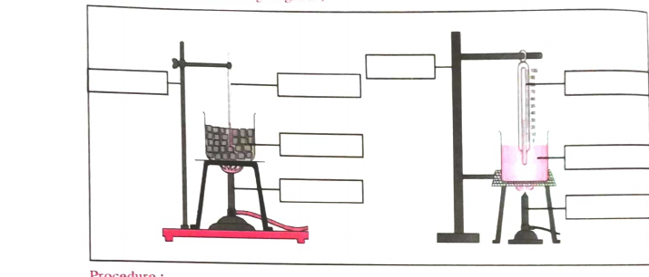
Practical 5: Effect of Heat on Ice (Graph)
From the journal
Heat ice, record temperature every minute, plot temperature vs time
Table starts at 0 °C at 0 min
Conclusion: heat is absorbed as ice → water → vapour
Answers for the blanks / MCQs
Result explained
Readings: enter your own, none invented
MCQ: 1 b; 2 a; 3 d; 4 a; 5 c (salt)
Ex 1: flat lines at start and end: temperature constant during melting and boiling
Ex 2: heat absorbed with no temperature rise is latent heat
Temperature stays flat while ice melts and while water boils, because the heat supplied changes the state instead of raising temperature. That heat is latent heat.
Practical 5 · Journal pp. 14–15

Slide 10
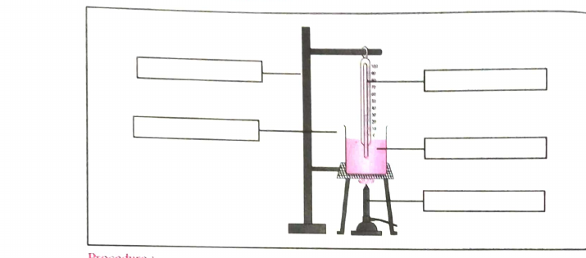
Practical 6: Natural Cooling of Hot Water
From the journal
Heat water to 100 °C, switch off, record from 70 °C every minute
Plot temperature vs time
Precautions: fans off; clock runs continuously
Answers for the blanks / MCQs
Result explained
Conclusion: rate of cooling is high when difference from surroundings is large; rate decreases as water cools
MCQ: 2 b; 4 b; 5 d
MCQ 1 and 3 are graph or figure choices: verify
Ex 2: 80 °C water cools faster (bigger difference)
Hot water loses heat fastest at first because the gap from room temperature is largest. As the gap narrows the cooling slows, giving a curve that flattens out.
Practical 6 · Journal pp. 16–18

Slide 11
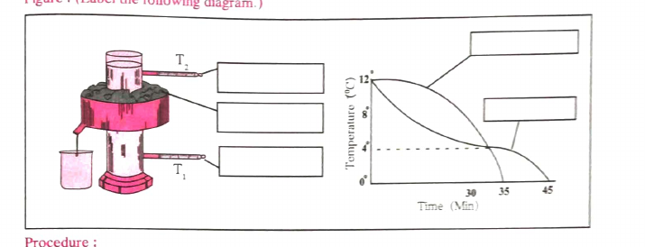
Practical 7: Anomalous Behaviour of Water (Hope’s Apparatus)
From the journal
Cold water (10–12 °C) in inner cylinder; ice and salt mixture outside
Thermometers T₁ (lower) and T₂ (upper)
Graph: T₁ and T₂ curves meet near 4 °C
Answers for the blanks / MCQs
Result explained
1: water contracts as temperature falls; both readings differ
2: below 4 °C water expands, becomes lighter, rises
3: anomalous expansion of water
Page 20 scan blurry: MCQs 1 to 5 and exercises verify before answering
Water is densest at 4 °C. Cooling to 4 °C makes water sink, but below 4 °C it expands and rises, so the lower thermometer reaches 4 °C first.
Practical 7 · Journal pp. 19–20

Slide 12
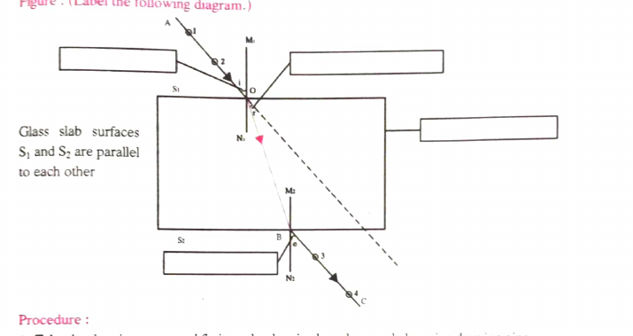
Practical 8: Laws of Refraction (Glass Slab)
From the journal
Angles of incidence 30°, 45°, 60°
Journal entries: r = 20°, 24°, 32°; e = 30°, 47°, 59° (verify, e should equal i)
Answers for the blanks / MCQs
Result explained
Inference: incident ray and emergent ray are parallel; i and e are same
MCQ: 1 b; 2 c; 3 b; 4 b; 5 verify
Ex 2: opposite parallel faces give equal and opposite bending
Light bends towards the normal entering glass and away on leaving. With parallel faces the two bends cancel, so the emergent ray is parallel to the incident ray and e equals i.
Practical 8 · Journal pp. 21–22

Slide 13
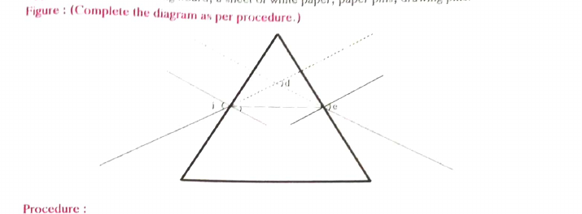
Practical 9: Path of Light through a Prism
From the journal
Draw PQ at 30°, fix pins, trace emergent ray
Journal row 1: i = 30°, r = 30°, d = 22° (r value: verify)
Answers for the blanks / MCQs
Result explained
Inference: deviation first decreases, then increases with angle of incidence
MCQ: 1 a; 2 d; 3 d; 4 a; 5 a
Ex 1: red deviates least
Ex 2: angle of minimum deviation; it differs for different colours
A prism bends light at both faces, so the ray deviates from its original path. Deviation falls to a minimum as the angle of incidence grows, then rises again.
Practical 9 · Journal pp. 23–24

Slide 14
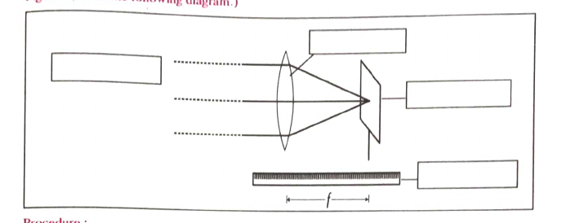
Practical 10: Focal Length of a Convex Lens
From the journal
Image a distant object on a screen; measure lens to screen
Repeat 3 times; rotate lens 180° for F₂
Answers for the blanks / MCQs
Result explained
Readings and F₁, F₂: your own measurements
If F₁ = F₂ the lens is symmetric
MCQ: 1 c; 2 b; 3 c; 4 c; 5 b
Ex 3: equal F₁ and F₂ means equi-convex symmetric lens
Rays from a distant object are nearly parallel, so a convex lens brings them to a point on the screen. The lens-to-screen distance is the focal length.
Practical 10 · Journal pp. 25–26

Slide 15
Practical 11: Reactivity of Metals
From the journal
Result explained
Metals Zn, Fe, Cu, Al with solutions of their sulphates
Table: Al displaces Zn, Fe, Cu; Zn displaces Fe, Cu; Fe displaces Cu; Cu none
A more reactive metal displaces a less reactive one from its salt solution. The pattern of reactions gives the order Al, Zn, Fe, Cu.
Answers for the blanks / MCQs
Decreasing reactivity: Al > Zn > Fe > Cu
MCQ: 1 b; 2 c; 3 d; 4 d; 5 a
Ex 1: remove oxide layer; Ex 2: a metal cannot displace itself
Ex 3: fluorine > chlorine > bromine > iodine
Practical 11 · Journal pp. 27–28

Slide 16
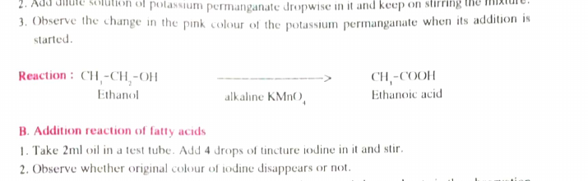
Practical 12: Oxidation and Addition Reactions of Carbon Compounds
From the journal
A Ethanol → ethanoic acid with alkaline KMnO₄
B Iodine with oils: coloured solution turns colourless
Table of oil colour changes: record your own
Answers for the blanks / MCQs
Result explained
A: ethanoic acid; pink colour vanishes
B: addition reaction; vanaspati ghee is saturated, no change
MCQ: 1 c; 2 c; 3 a; 5 c; Q4 verify
Ex: ethanol is a sugar industry byproduct; catenation is carbon bonding to itself; ethanol blending cuts pollution
KMnO₄ oxidises ethanol to ethanoic acid, so its pink colour fades. Iodine adds across C=C double bonds of unsaturated oils and decolourises; saturated vanaspati ghee has none.
Practical 12 · Journal pp. 29–30

Slide 17
Revision
From the journal
Result explained
Reactions: precipitation, combination, decomposition, displacement
Physics: magnetism, heat, refraction, prism, lens
Metals and carbon compounds
Use the slides as a quick check: the practical name tells you the reaction type, the observation tells you the result, and the explanation tells you why.
Answers for the blanks / MCQs
Halide ions: AgCl white, AgBr light yellow, AgI bright yellow
Reactivity: Al > Zn > Fe > Cu
Water is densest at 4 °C
Revision · Journal pp. 2–30

